Slide 1
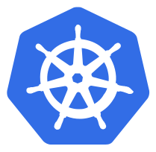
Kubernetes (K8S)

Slide 2
Table of Contents
Overview
Kubernetes Introduction
Kubernetes Architecture
Containers
Workloads
Deployment
Networking
Storage
Configuration
Cluster Administration
Troubleshooting
Training

Slide 3
Introduction
The purpose of this document is to provide a high-level overview of Kubernetes (K8) and provide training links. After going through this document, you should have a high-level understanding of Kubernetes and it’s key components and functions. The document will describe how PV First utilizes Kubernetes. In addition, the document will cover key topics for Kubernetes even if they are not used in PV First.
The majority of this deck’s content has come directly from Kubernetes documentation.

Slide 4
What is Kubernetes (K8s)
Kubernetes is a container orchestration tool designed to help automate the deployment, scaling and management of containerized applications. Containers are grouped into logical units for easy management and discovery. Since Kubernetes is open source, the solution can be implemented on-premises or in the cloud (hybrid, public or private).

Slide 5
Why Kubernetes?
Kubernetes is a production-grade, open-source infrastructure for the deployment, scaling, management, and composition of application containers across clusters of host. It is primarily targeted at applications composed of multiple containers. It therefore groups containers using pods and labels into tightly coupled and loosely coupled formations for easy management and discovery.

Slide 6
What Kubernetes is not
Kubernetes is not a traditional, all-inclusive PaaS (Platform as a Service) system. Since Kubernetes operates at the container level rather than at the hardware level, it provides some generally applicable features common to PaaS offerings, such as deployment, scaling, load balancing, logging, and monitoring. However, these solutions are optional and pluggable. Kubernetes should be used to provide the building blocks for the platform because it preserves user choice and flexibility where it is important.
Kubernetes does not:
Limit the type of applications supported
If the application can run in a container, then it is a candidate for Kubernetes. K8 aims to support a diverse variety of workloads including stateless, stateful and data-processing workloads.
Deploy source code or build an application
Continuous Integration, Delivery and Deployment (CI/CD) workflows are independent of K8. The CI/CD workflow should be determined by an organization’s culture and preferences as well as its technical requirements.
Provide application-level services
Application-level services such as middleware (e.g. message buses), data-processing frameworks (e.g. Spark), databases (e.g. mySQL) ,caches and cluster storage systems (e.g. Ceph) are not built-in services. Such components can run on Kubernetes and/or be accessed by applications running on Kubernetes.
Dictate logging, monitoring or alerting solutions
There are several integrations of solutions used as proof concepts, but rather than dictate the solutions for logging, monitoring and alerting, K8 provides the flexibility for user choice.
Configuration
Provide/mandate a configuration language/system, maintenance, management or self-healing systems.

Slide 7
Benefits of Kubernetes (K8s)
Kubernetes provides a container-centric management environment. It orchestrates computing, networking, and storage infrastructure on behalf of user workloads. This provides much of the simplicity of Platform as a Service (PaaS) with the flexibility of Infrastructure as a Service (IaaS), and enables portability across infrastructure providers.
Kubernetes provides the following features:
Horizontal Scaling:
Self-healing:
Secret and Configuration Management:
Automatic Deployment:
Metrics:
Scale the containers on the fly to handle any spikes in workloads
Automatically restart and redeploy containers if they are identified as “unhealthy”
Externalize application configurations and account credentials without exposing them within the stack configuration and limiting the number of rebuild/recompilation required
Based on resource requirements and availability, containers are deployed to nodes to best balance the application workload
Monitor and gather resource usage and performance metrics

Slide 8
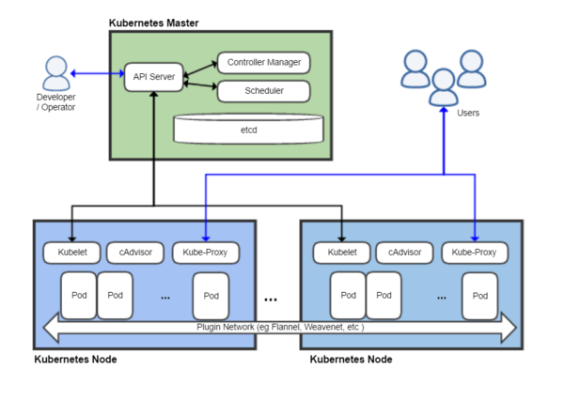
Kubernetes Architecture
A running Kubernetes cluster contains node agents (kubelet) and a cluster control plane (AKA master), with cluster state backed by a distributed storage system (etcd).
A node is a worker machine in Kubernetes (K8s), previously known as a minion. A node is not inherently created by Kubernetes, instead it is a VM or physical machine created externally (e.g. GCP, AWS, on-premise data center, etc.).
Each node has the services necessary to run pods and is managed by the master components. The services on a node include Docker, kubelet and kube-proxy. These services will be covered in more detail later in the deck.

Slide 9
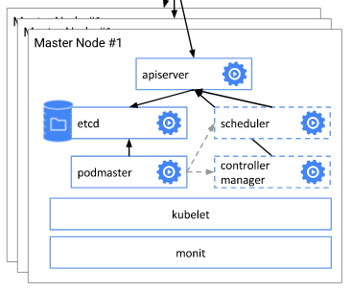
Cluster Control Plane (Master Node)
The Kubernetes control plane is split into a set of components, which can all run on a single master node or can be replicated in order to support high-availability clusters.
Kubernetes provides a REST API supporting primarily CRUD operations on (mostly) persistent resources, which serve as the hub of its control plane. The API provides IaaS-like container-centric resources such as Pods, Services, and Ingress, and also lifecycle APIs to support orchestration (self-healing, scaling, updates, termination) of common types of workloads.

Slide 10
API Server
The API server acts as the gateway to the cluster. By definition, the API server must be accessible by clients from outside the cluster whereas the nodes and containers may not be. Clients authenticate the API server and also use it as a bastion and proxy/tunnel to nodes and pods (and services).
Kubernetes cannot function without this basic API machinery, which includes:
REST semantics, watch, durability and consistency guarantees, API versioning, defaulting, and validation
Built-in admission-control semantics, synchronous admission-control hooks, and asynchronous resource initialization
API registration and discovery
It is intended to be a relatively simple server, with most/all business logic implemented in separate components or in plug-ins. It mainly processes REST operations, validates them, and updates the corresponding objects in etcd. All persistent cluster state is stored in an instance of etcd.

Slide 11
Controller Manager
Most other cluster-level functions are currently performed by a separate process, called the Controller Manager. It performs both lifecycle functions (e.g., namespace creation and lifecycle, event garbage collection, terminated-pod garbage collection, cascading-deletion garbage collection, node garbage collection) and API business logic (e.g., scaling of pods controlled by a ReplicaSet).
The application management and composition layer provides self-healing, scaling, application lifecycle management, service discovery, routing, and service binding and provisioning.

Slide 12
Scheduler
Kubernetes enables users to ask a cluster to run a set of containers. The scheduler component automatically chooses hosts to run those containers on.
The scheduler watches for unscheduled pods and binds them to nodes according to the availability of the requested resources, quality of service requirements, affinity and anti-affinity specifications, and other constraints.

Slide 13
Kubernetes Nodes
Each node has the services necessary to run pods and is managed by the master components. The services on a node include Docker, kubelet and kube-proxy.
A number of components, called add-ons typically run on Kubernetes itself:
Domain Name Service (DNS)
Ingress Controller
Heapster
Kubernetes Dashboard (GUI)

Slide 14
Kubelet
The most important and most prominent controller in Kubernetes is kubelet which is the primary implementer of pod and node APIs that drive the container execution layer.
Kubernetes manages isolated application containers. Not only are application containers isolated from each other, but they are also isolated from the hosts on which they reside on. This is critical to decoupling management of individual applications from each other and from management of the underlying cluster’s infrastructure. Kubernetes provides pods that can host multiple containers/storage volumes and decoupling deployment-time concerns from build-time concerns..
API admission control may reject pods or add additional scheduling constraints to them, but kubelet is the final arbiter of what pods can and cannot run on a given node, not the schedulers or DaemonSets.

Slide 15
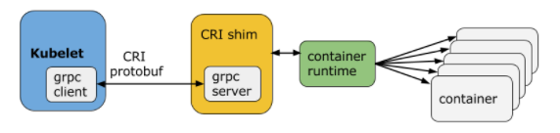
Container Runtime
Each node runs a container runtime which is responsible for downloading images and running containers. Runtimes supported today include at least docker (for Linux and Windows), rkt, cri-o, and frakti. The Container Runtime Interface (CRI) is a plugin interface which enables kubelet to use a wide variety of container runtimes, without the need to recompile.
Kubelet communicates with the container runtime (or a CRI shim for the runtime) over Unix sockets using the gRPC framework, where kubelet acts as a client and the CRI shim as the server.
The protocol buffers API includes two gRPC services, ImageService, and RuntimeService. The ImageService provides RPCs to pull an image from a repository, inspect, and remove an image. The RuntimeService contains RPCs to manage the lifecycle of the pods and containers, as well as calls to interact with containers (exec/attach/port-forward).

Slide 16
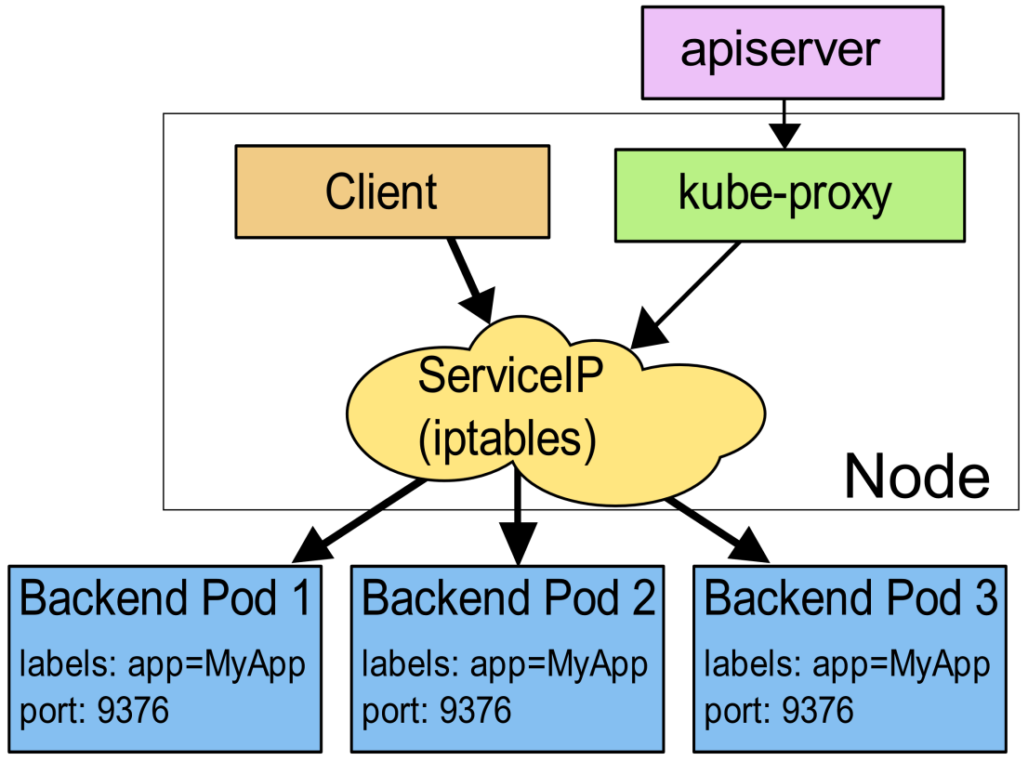
Kube-Proxy
The service abstraction provides a way to group pods under a common access policy (e.g., load-balancer). The implementation of this creates a virtual IP which clients can access and which is transparently proxied to the pods in a Service. Each node runs a kube-proxy process which programs iptables rules to trap access to service IPs and redirect them to the correct backends.
This provides a highly-available load-balancing solution with low performance overhead by balancing client traffic from a node on that same node.

Slide 17
Kube-DNS
Starting from Kubernetes v1.3, DNS is a built-in service, kube-dns, launched automatically using the addon manager. Kubernetes DNS schedules a DNS Pod and Service on the cluster, and configures kubelet to tell individual containers to use the DNS Service’s IP to resolve DNS names. Every Service defined in the cluster (including the DNS server itself) is assigned a DNS name. By default, a client Pod’s DNS search list will include the Pod’s own namespace and the cluster’s default domain.
The running Kubernetes DNS pod holds 3 containers:
“kubedns”: The kubedns process watches the Kubernetes master for changes in Services and Endpoints, and maintains in-memory lookup structures to serve DNS requests.
“dnsmasq”: The dnsmasq container adds DNS caching to improve performance.
“healthz”: The healthz container provides a single health check endpoint while performing dual healthchecks (for dnsmasq and kubedns).
Services and troubleshooting the DNS will be covered later in the deck.

Slide 18
Heapster
Heapster enables Container Cluster Monitoring and Performance Analysis for Kubernetes. It collects and interprets various signals like compute resource usage, lifecycle events, etc.
Heapster can run on a Kubernetes cluster using a number of backends. Some common choices:
InfluxDB
Stackdriver Monitoring and Logging for Google Cloud Platform (GCP)
Notes:
PV First utilizes the following:
https://github.com/kubernetes/heapster/tree/master/deploy/kube-config/influxdb

Slide 19
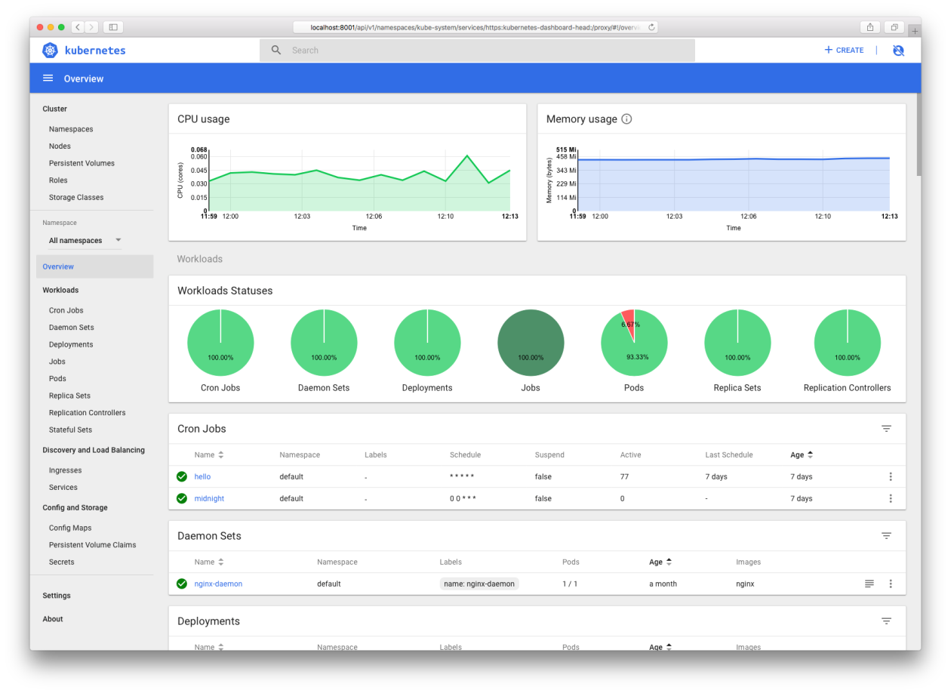
Dashboard
Kubernetes Dashboard is a general purpose, web-based UI for Kubernetes clusters. It allows users to manage applications running in the cluster and troubleshoot them, as well as manage the cluster itself.
Notes:
Something we should look into: https://github.com/kubernetes/dashboard/wiki/Access-control

Slide 20
Cluster -> Master Communication
All communication paths from the cluster to the master terminate at the apiserver. In a typical deployment (including PV First), the apiserver is configured to listen for remote connections on a secure HTTPS port (443).
Pods that wish to connect to the apiserver can do so securely by leveraging a service account so that Kubernetes will automatically inject the public root certificate and a valid bearer token into the pod when it is created. Kubernetes services (in all namespaces) are configured with a virtual IP address that is redirected (via kube-proxy) to the HTTPS endpoint on the apiserver.

Slide 21
Master -> Cluster Communication
There are two primary communication paths from the master (apiserver) to the cluster. The first is from the apiserver to the kubelet process which runs on each node in the cluster. The second is from the apiserver to any node, pod, or service through the apiserver’s proxy functionality.
Since PV First utilizes communication path from the apiserver to kubelet, this communication will be covered further.
The connections from the apiserver to the kubelet process are used for the usage of kubectl and providing kubelet’s port-forwarding functionality. Kubectl will be covered in more detail later in this deck, but at a high level, kubectl can be used for:
Basic commands (i.e. create, display and delete a resource)
Deploy commands (i.e. rolling updates and scaling)
Cluster management commands (i.e. display cluster info, resource usage and manage the nodes)
Troubleshooting and debugging commands (i.e. fetch logs, describe resources and attach to a resource)

Slide 22
Node Status
Node Condition | Description
OutOfDisk | True if there is insufficient free space on the node for adding new pods False otherwise
Ready | True if the node is healthy and ready to accept pods False if the node is not healthy and not accepting pods Unknown if the node controller has not heard from the node in the last 40 seconds
MemoryPressure | True if pressure exists on the node memory (i.e. memory is low) False otherwise
DiskPressure | True if pressure exists on the disk size (i.e. disk capacity is low) False otherwise
NetworkUnavailable | True if the network for the node is not correctly configured False otherwise
ConfigOK | True if kubelet is correctly configured False otherwise
A node has a status with the following information:

Slide 23
Network Overview
By design, Kubernetes does not install a networking solution upon creation of the cluster. Kubernetes aims to preserve user choice and flexibility where it is important. This means a third-party CNI-compliant networking solution must be installed by using kubectl apply.
While there are numerous networking solutions given as examples in Kubernetes documentation, the most commonly used seem to be Calico, Flannel and Weave Net. Since PV First utilizes Weave Net, the deck will focus on Weave Net.

Slide 24
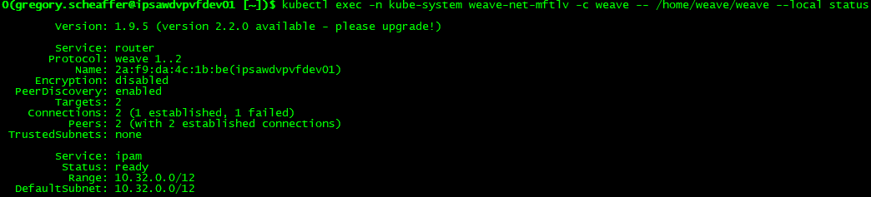
Weave Net
Weave Net can be installed to the CNI-enabled Kubernetes cluster with a single command. After a few seconds, a Weave Net pod will be running on each node and any future pods created will automatically be attached to the Weave network.
While many Kubernetes network issues occur at a higher level than Weave Net (i.e. Pod Networking & Network Policies), there are a few troubleshooting activities that can be used to identify whether the issue is with Weave Net or other Kubernetes networking.
The above shows all Weave Net pods available in your cluster. You can see Kubernetes has deployed one Weave Net pod per host, in order to enable communication between all hosts.
You then need to:
choose which pod you want to run your command from (in most cases it doesn’t matter which one you pick so just pick the first one, e.g. pod weave-net-mftlv here)
use kubectl exec to run the weave status command
specify the absolute path /home/weave/weave and add --local because it’s running inside a container
Since the status is ready, the issue is not with Weave Net.

Slide 25
Kubernetes Cluster Objects
The following Kubernetes topics will be covered in this deck:
Containers
Workloads
Configuration
Services, Load Balancing & Networking
Storage

Slide 26
Images
Kubernetes uses images create from the container runtime that is implemented within the cluster. Docker is the container runtime used by PV First and will be used as the example
A Docker image is created and pushed to a registry (DockerHub) before referring to it in a Kubernetes pod.
The default pull policy is IfNotPresent which causes the kubelet to not pull an image if it already exists. To change this, set the imagePullPolicy of the container to Always. While using the :latest tag is alternative option to force an image pull, it has been deprecated and does not follow best practices. The use of :latest makes it difficult to track versions of an image when deployed and limits the ability to roll back.
Private registries may require keys to read images from them. Credentials can be provided in several ways:
https://kubernetes.io/docs/concepts/containers/images/

Slide 27
Container Environment Variables
The Kubernetes container environment provides several important resources to containers:
A filesystem which is a combination of an image and one or more volumes
Information about the container itself
Information about other objects in the cluster
Container Information:
The hostname of a container is the name of the pod in which the container is running.
The pod name and namespace are available as environment variables
User-defined environment variables from pod definitions (i.e. ConfigMap, Secrets) are available
Statically defined environment-variables from the image (i.e. Dockerfile) are available
Cluster Information:
A list of all services that were running when the container was created are available as environment variables
Services have dedicated IP addresses and are available to a container via DNS when the DNS addon is enabled.

Slide 28
Kubernetes Pods
This section provides an overview of a Pod, the smallest deployable object in Kubernetes, which represents a running process within the cluster.
A pod is the combination of an application container (or in some cases, multiple containers), storage resources, a unique network IP, and options on how the container(s) should run. A pod represents a unit of deployment: a single instance of an application in Kubernetes.
There are two main ways that a Kubernetes pod is used within a cluster:
Single Container Pod: The “one-container-per-pod” model is the most common Kubernetes use case. The pod is used as a wrapper around a single container with its’ storage resources, networking and options. Kubernetes manages the pod rather than the container directly.
Multi-Container Pods: A pod might contain an application composed of multiple co-located containers that are tightly coupled and need to share resources. These co-located containers might form a single process or application – one container is serving files from a shared volume to the public, while a separate “sidecar” container refreshes or updates those files. The pod wraps these containers and storage resources together as a single manageable entity.

Slide 29
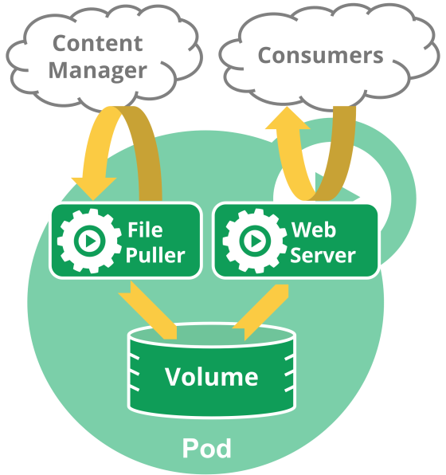
Multi-Container Pods
An example of a multi-container pod contains a container that acts as a web server for files in a shared volume and a separate “sidecar” container that updates those files from a remote source.
This co-location and co-management of multiple containers within a single pod should only be used in specific instances where containers need to be tightly coupled.
The containers within the pod are automatically scheduled and hosted on the same node within the cluster. The containers share resources and dependencies, communicate with each other and coordinate how they are terminated.

Slide 30
Pod Networking
Each pod is assigned a unique IP address regardless of the number of containers within a pod. Each container within the pod shares the network namespace which includes the IP address and network ports.
Containers within the pod can communicate using localhost. However, processes outside of the pod (i.e. other pods, databases (MongoDB), messaging solutions (Kafka) must communicate through the Services created for the pod.

Slide 31
Pod Storage
A pod can have a storage volumes attached where all containers within the pod have access. This enables the containers within the pod to share data. Volumes allow for data to be persisted beyond the lifespan of the container(s) within the pod.
Volumes will be covered in more detail later within the deck.

Slide 32
Pod Lifecycle
A pod’s status is determined by it’s phase. The phase is a simple, high-level summary of where the pod is in within its lifecycle. The possible values for phase are:
Pending: The pod has been accepted by the Kubernetes system, but one or more of the containers have not been created. This also includes time before being scheduled as well as the time to download images from the container registry.
Running: The pod has been bound to a node, all of the containers have been created and/or at least one container is still running.
Succeeded: All containers in the pod have terminated successfully and will not be restarted.
Failed: All containers within the pod have been terminated, but at least one container has exited with a non-zero status or was terminated by the system.
Unknown: The state of the pod could not be obtained
PodStatus has an array of PodConditions with types such as “PodScheduled”, “Ready”, “Inititiailized” and “Unscheduleable” with a status of “True”, “False” and “Unknown”.
Typically, pods do not disappear until someone destroys them. This might be a human or a controller; however, the exception to the rule is pods with a phase of Succeeded or Failed for a pre-determined duration will expire and be terminated.
A pod has a restartPolicy with possible values Always, OnFailure, and Never. The default value is Always and applies to all containers in the pod. Failed containers that are restarted by the kubelet are restarted with an exponential back-off delay (10s, 20s, 40s …) capped at five minutes, and is reset after ten minutes of successful execution.

Slide 33
Container Probes
A Probe is a diagnostic performed periodically by the kubelet on a Container. To perform a diagnostic, the kubelet calls a Handler implemented by the Container. There are three types of handlers:
ExecAction: Executes a specified command inside the Container. The diagnostic is considered successful if the command exits with a status code of 0
TCPSocketAction: Performs a TCP check against the Container’s IP address on a specified port. The diagnostic is considered successful if the port is open.
HTTPGetAction: Performs an HTTP Get request against the Container’s IP address on a specified port and path. The diagnostic is considered successful if the response has a status code greater than or equal to 200 and less than 400.
The kubelet can optionally perform and react to two kinds of probes on running Containers:
livenessProbe: Indicates whether the Container is running. If the liveness probe fails, the kubelet kills the Container, and the Container is subjected to its restart policy. If a Container does not provide a liveness probe, the default state is Success.
readinessProbe: Indicates whether the Container is ready to service requests. If the readiness probe fails, the endpoints controller removes the Pod’s IP address from the endpoints of all Services that match the Pod. The default state of readiness before the initial delay is Failure. If a Container does not provide a readiness probe, the default state is Success

Slide 34
Pod Disruption
Pods do not disappear until someone (a person or a controller) destroys them or there is an unavoidable hardware/software error. Kubernetes breaks down pod disruptions to two types: involuntary disruptions and voluntary disruptions.
Involuntary Disruptions:
These disruptions are typical conditions that are not specific to Kubernetes
Examples:
Hardware failure on the machine backing the node
Hypervisor failure
Kernel panic
Node disappears from the cluster
Eviction of a pod due to resources
Voluntary Disruptions:
These disruptions include actions initiated by the application owner and a cluster administrator
Examples:
Deleting a deployment or other controller that manages the pod
Updating a deployment’s pod template causing a restart
Directly deleting a pod
Draining a node

Slide 35
Kubernetes Workloads
As previously discussed, a pod represents a unit of deployment: a single instance of an application in Kubernetes. In order to mitigate pod disruptions and downtime for the application, there are several methods of replication available within Kubernetes.

Slide 36
ReplicationController
A ReplicationController ensures that a specified number of pod replicas are running at a given time. If there are too many pods, the ReplicationController terminates the extra pods. If there are too few pods, then the ReplicationController creates more pods. The pods maintainted by the ReplicationController are automatically replaced if they fail, are deleted or are terminated.
Note: A Deployment that configures a ReplicaSet is now the recommended way to set up replication.

Slide 37
ReplicaSet
ReplicaSet is the next-generation ReplicationController which is mainly used by Deployment as a mechanism to orchestrate pod creation, deletion and updates. The only difference between a ReplicaSet and a Replication Controller right now is the selector support. ReplicaSet supports the new set-based selector requirements. Set-based label requirements allow filtering keys according to a set of values. Three kinds of operators are supported: in,notin and exists (only the key identifier).
Note: It is recommended to use Deployments instead of directly using Replica Sets, unless you require custom update orchestration or don’t require updates at all. When you use Deployments you don’t have to worry about managing the ReplicaSets that they create. Deployments own and manage their ReplicaSets.

Slide 38
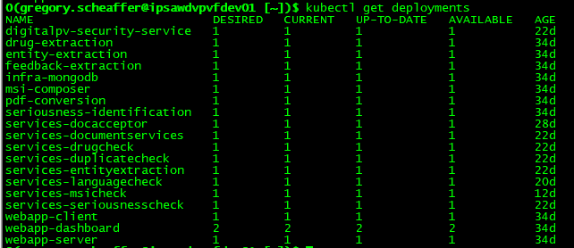
Deployment
A Deployment controller provides declarative updates for Pods and ReplicaSets. ReplicaSets and Pods are not managed by the cluster admin, rather than through manipulation of the Deployment object. A desired state is described and the Deployment controller changes the actual state of the deployment to the desired state at a controlled rate.
Common use cases of a Deployment include:
Rollout of a ReplicaSet to create pods
Rollback to a previous version of the pods
Scale pods to facilitate the load
A Deployment’s rollout is triggered if and only if the Deployment’s pod template (.spec.template) is changed

Slide 39
Rolling Back a Deployment
Sometimes a Deployment will need to be rolled back. This could be due to instability, such as a crash loop, or the containers need to be rolled back to a previous version. In order to do this, the following command is run:
kubectl set image deployments <POD_NAME> <CONTAINER_NAME>=<IMAGE_NAME>:<VERSION>
This will implement a rolling update of all pods that are the older version one at a time. At least one instance of the pod will be running until the update is complete. The exact number of instances will be depended on the Desired value defined in the Deployment

Slide 40
Scaling a Deployment
There are two ways of scaling a deployment: manual and auto-scaling.
Manual Scaling:
In order to manually scale a deployment, the following command must be run:
kubectl scale deployment <DEPLOYMENT-NAME> --replicas=10
Auto-Scaling:
An autoscaler can be configured to determine the minimum and maximum number of pods you want to run based on the CPU utilization of your existing pods.

Slide 41
StatefulSets
StatefulSets are used to manage stateful application. A StatefulSet manages the deployment and scaling of a set of pods and provides guarantees about the ordering and uniqueness of the pods. Unlike a Deployment, a StatefulSet maintains a sticky identity for each of their Pods. These pods are created from the same spec, but are not interchangeable. Each has a persistent identifier that it maintains across any rescheduling.
StatefulSets are valuable for applications that require one or more of the following.
Persistent, unique network identifiers.
Persistent, persistent storage.
Ordered, graceful deployment and scaling.
Ordered, graceful deletion and termination.
Ordered, automated rolling updates.

Slide 42
DaemonSet
A DaemonSet ensures that all (or some) nodes have a copy of a pod running. As nodes are added to the cluster, pods are added to them. As nodes are removed from the cluster, those pods are removed. If you delete a DaemonSet, the pods it created will be deleted.
Typical use cases of a DaemonSet are:
Running a cluster storage daemon, such as glusterd, ceph, etc., on each node.
Running a logs collection daemon on every node, such as fluentd or logstash, etc.
Running a node monitoring daemon on every node, such as Prometheus, collectd, etc.
Running a network daemon on every node, such as Weave Net, Kube-Proxy, etc.

Slide 43
Configuration Best Practices
Write configuration files using YAML rather than JSON. Though these formats typically can be used interchangeable, YAML tends to be more user-friendly.
Don’t use naked pods (i.e. pods not bound to a ReplicaSet or Deployment) if it can be avoid it. Naked Pods will not be rescheduled in the event of a node failure.
Create a Service before its corresponding backend workloads (Deployments or ReplicaSets), and before any workloads that need to access it. When Kubernetes starts a container, it provides environment variables pointing to all the Services which were running when the container was started.
Don’t specify a hostPort for a Pod unless it is absolutely necessary. When a Pod bound to a hostPort, it limits the number of places the Pod can be scheduled, because each <hostIP, hostPort, protocol> combination must be unique.
Avoid using hostNetwork, for the same reasons as hostPort.
Define and use labels that identify semantic attributes of your application or Deployment, such as { app: myapp, tier: frontend, phase: test, deployment: v3 }. You can use these labels to select the appropriate Pods for other resources;

Slide 44
Compute Resource Allocation
When creating a pod, you can optionally specify how much CPU and memory (RAM) each container requires (i.e. requests) and the limits. When these metrics are identified and used, the scheduler can make more informed decision on which node to deploy the pod to.
Each container of a pod can specify one or more of the following:
CPU request
CPU limit
Memory request
Memory limit
While theses are defined at the container level, the pod resource requests and limits is the sume of the resource requests/limits for the resource (i.e. containers).
When a pod is created, the scheduler selects a node for the pod to run on. Each node has a maximum capacity for each of the resource types – the amount of CPU and memory available. The scheduler will ensure the sum of the pod’s compute resource request is less than the capacity available on the node.
If a container exceeds the limits provided, it may be evicted from the node (or terminated) and restarted on a different node.

Slide 45
Taints and Tolerations
Taints on a node allow the node to repel a set of pods. Taints and tolerations work in parallel to prevent pods from being scheduled on inappropriate nodes. If one or more taints are applied to a node, then the node should not accept any pods that do not tolerate the taint(s). Tolerations are applied to pods and allow the pods to be scheduled onto nodes with matching taints.
By default, a newly created cluster will not schedule pods on the master for security reasons. If you want to be able to schedule pods on the master, the taint must be removed. This will enable the scheduler to schedule pods on any node.
Use cases for taints and tolerations include:
Dedicated Nodes: In a cluster, there may be a subset of nodes that need to be reserved for exclusive use of a particular set of users. In order to achieve this, you can add a taint to those nodes and add the corresponding toleration to the pods of the specific users.
Nodes with Special Hardware: In a cluster where there is subset of nodes that have specialized hardware (ex. GPUs), a taint and toleration can be put in place to prevent pods that do not require the specialized software to be scheduled. This will leave room for future pods to be deployed to the subset of nodes.

Slide 46
Secrets
Secrets are designed to hold sensitive information such as credentials, Oauth tokens and ssh keys. The use of Secrets provides greater flexibility and security for this information in comparison to putting it within the pod definition (i.e. YAML) or in a Docker image (i.e. Dockerfile or application.properties).
Built-in Secrets:
Kubernetes automatically creates secrets which contain credentials for accessing the API and it automatically modifies your pods to use this type of secret.
Custom Secrets:
Custom secrets can be created to handle the pod’s use of credentials like a database.
Secrets can be mounted as data volumes or be exposed as environment variables to be used by a container in a pod. They can also be used by other parts of the system, without being directly exposed to the pod. A secret is only sent to a node if a pod on that node requires it. It is not written to disk. It is stored in a tmpfs and does not come to rest on the node. It is deleted once the pod that depends on it is deleted.
There may be secrets for several pods on the same node. However, only the secrets that a pod requests are potentially visible within its containers. Therefore, one Pod does not have access to the secrets of another pod.

Slide 47
Networking
Kubernetes pods are ephemeral in nature. While there are controllers that handle the replication and creation of pods when they die, these pods are made of new containers. The container creation (and destruction) is handled dynamically. Each pod will be given it’s own IP address, but due to the nature of pods and containers, the IP address can not be relied on.
As a result, Kubernetes provides several networking solutions that will help achieve the stability required for networking.

Slide 48
Service
A Service is a policy that defines how a pod is accessed. The pod, or set of pods, that are targeted by a Service is typically defined by a Label Selector. The value of the Label Selector is matched to a label that is within a pod’s definition.
Each Service is assigned a unique IP address (also called clusterIP). This address is tied to the lifespan of the Service. It will not change while the Service is alive. Pods can be configured to talk to the Service and the communication to the Service will be automatically load-balanced out to one pod that is a member of the Service through endpoints. Each pod will be given an endpoint and the endpoint is automatically removed and disassociated from the Service when the pod dies. New pods with the matching selector will have their endpoints get automatically added.

Slide 49
Accessing the Service – DNS & Environment Variables
Kubernetes supports two primary modes of finding a Service – DNS and environment variables.
Environment Variables:
When Kubernetes starts a container, it provides environment variables pointing to all the Services which were running when the container was started. As a result, it is best practice to create Services before deploying a Pod.
DNS:
Kubernetes offers a DNS cluster add-on Service, kube-dns, which automatically assigns DNS names to Services. The DNS add-on schedules a Pod and Service on the cluster which configures kubelet to force containers to use the DNS Service’s IP address to resolve DNS names.
Every Service defined in the cluster (including the DNS server itself) is assigned a DNS name. The DNS pod watches Kubernetes API for new Services and creates a set of DNS records for each.
For example, if there is a service called services-docacceptor within the default namespace, a DNS record for “services-docacceptor.default” is created. Pods within the default namespace should be able to find it by doing a name lookup of services-docacceptor while pods within other namespaces must qualify the name as services-docacceptor.default.
For more information on DNS records for Services and Pods, please refer to Kubernetes documentation.

Slide 50
Publishing the Service
There are four ServiceTypes which define how the service is exposed.
ClusterIP: This exposes the service on an internal IP within the cluster. The service will only be reachable from within the cluster. This is the default value.
NodePort: This exposes the service on each Node’s IP at a static port which is defined within the Service. A ClusterIP service will be automatically created to route the traffic from <NodeIP>:<NodePort> to <ClusterIP>:<TargetPort>. By default, the Kubernetes master will allocate a port from a range (default: 30000-32767) unless explicitly defined within the Service. Each Node will proxy that port (the same port number on every Node) into the Service.
LoadBalancer: This exposes the service externally using a cloud provider’s load balancer. NodePort and ClusterIP services will automatically be created which traffic is routed to from the external load balancer.
ExternalName: This maps the service to the contents of the externalName field by returning the CNAME record with it’s value.

Slide 51
Ingress
An Ingress is a collection of rules that allow inbound connections to reach the cluster services. It can be configured to give services externally-reachable URLs, load balance traffic, terminate SSL and more. However, simply creating the Ingress resource will not be enough because an Ingress controller is required.
For more information on Ingress, please review the Kubernetes documentation.

Slide 52
Storage
Containers are ephemeral in nature, regardless of container orchestration or runtime. Changes to the file system and file contents are lost when the container crashes. When the container is brought back up, the changes made in the previous container are lost since the container starts with a clean slate. Another common challenge faced with containers is how files are shared between containers.
Kubernetes provides several options on how to combat these challenges through volumes. There are two types of volumes: Volumes and PersistentVolumes.

Slide 53
Volumes
A Kubernetes volume simply a “directory” which is accessible to the containers within a pod. What backs the volume (ex. Azure, AWS, GCP, local, NFS, etc.) and whether there is data initially stored on the volume is entirely determined by the user.
Pods can use any number of them simultaneously. To use a volume, a pod specifies what volumes to provide for the pod and where to mount the volumes on the container.
The lifecycle of a volume is explicitly tied to the pod that is using it. A volume can outlive containers within the pod which will see the data preserved. But when the pod no longer exists, neither does the volume.

Slide 54
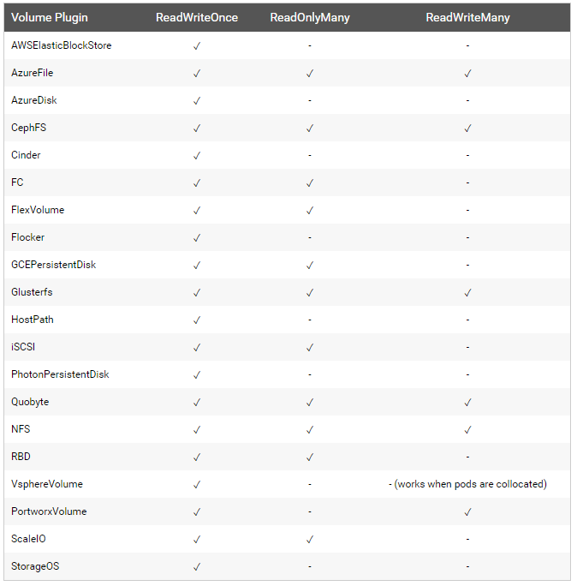
PersistentVolumes
PersistentVolume (PV) are a step above Kubernetes Volumes. A PV is a piece of storage in the cluster that has been provisioned by the administration. As the name suggests, the difference between a PV and Volume is its’ lifecycle. A PV has a lifecycle independent of any pod that uses it. If a pod no longer exists, the PV, and it’s data, will still exist.
A PersistentVolumeClaim (PVC) is a request for storage by a user. It is similar to a pod. Pods consume node resources and PVCs consume PV resources. PVCs can request a specific size and access mode for the PV. For example, the PV can only be mounted once read/write or many times read-only.

Slide 55
Cluster Administration
This section aims to provide insight and best practices for cluster administration. However, when it comes to design and administrator a cluster, not every cluster is the same. Solutions provided in this section may not be the best option for your specific cluster.

Slide 56
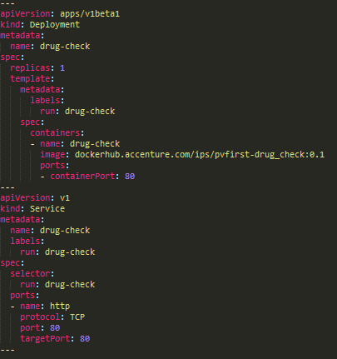
Yet Another Markup Language (YAML)
Yet Another Markup Language (YAML) is a human-readable format to specify configuration information. YAML is a superset of JSON, which means that any valid JSON file is also a valid YAML file. Though these formats typically can be used interchangeable, YAML tends to be more user-friendly and is the Kubernetes recommendation.

Slide 57
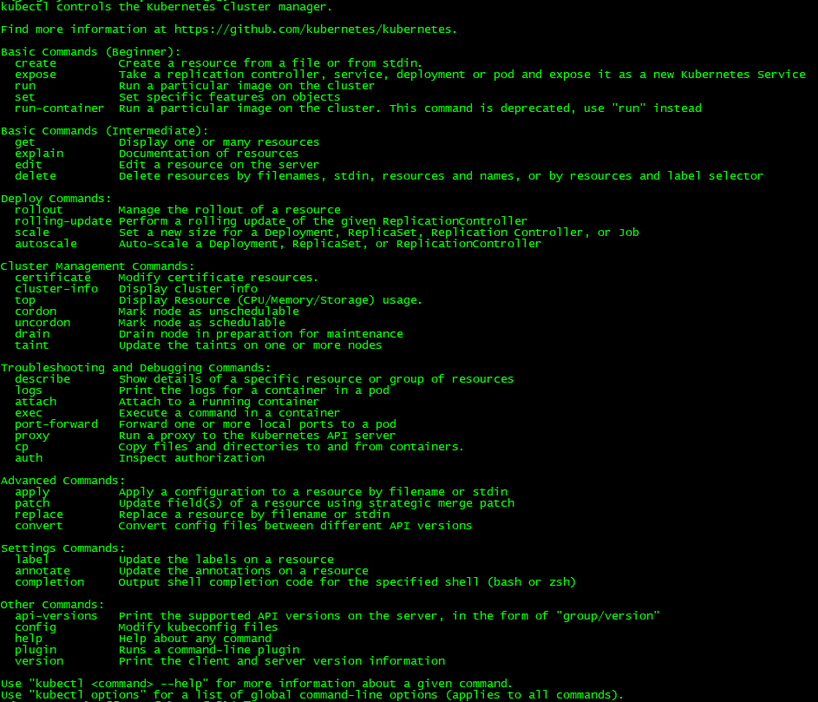
Kubectl
kubectl is a command line interface for running commands against Kubernetes clusters
For more information on kubectl, please review the documentation and overview of kubectl within Kubernetes documentation.

Slide 58
Kubernetes Dashboard
The Kubernetes Dashboard is a web-based user interface for Kubernetes. By default, the Dashboard is not deployed upon creation of the cluster. The Dashboard can be accessed either through the command-line interface (kubectl) or through a web browser as long as the service is exposed.
Through this UI, you can directly deploy to Kubernetes, troubleshoot the pods and manage the Kubernetes resources. In addition to the management of Kubernetes, the dashboard also provides information on the state of Kubernetes resources in your cluster, and on any errors that may have occurred.
By default, there is no security wrapped around the Dashboard. To fully secure the dashboard, RBAC should be implemented to limit the actions an end-user can do.

Slide 59
Federation
Kubernetes Federation makes it easy to manage multiple clusters. Through Kubernetes Federation, it provides the ability to keep resources in multiple clusters in sync and the ability to auto-configure DNS servers and load balancers across multiple clusters.
The two main use cases for Federation are:
High Availability: Spread the application across multiple clusters and auto configure DNS servers and load balancers. This enables two Kubernetes clusters to be in sync even if they do not reside in the same region. If one cluster does fail, then the Kubernetes cluster is still available through the second cluster.
Avoid Vendor Lock-In: The application is hosted on multiple-clusters that may reside on separate infrastructure vendors. For example, one cluster could be hosted on-premises while the other is hosted in the cloud.
Federation provides benefits beyond the main use cases above:
Low Latency: Utilizing clusters in multiple regions helps minimize latency by serving users from the cluster that is closest to them.
Fault Isolation: Depending on the use case, it may be better to design the application to utilize multiple small clusters rather than a single, large cluster.
Scalability: While there are limits to scalability with regards to a single cluster, this should not be the case for most users. However, if there are concerns with scalability, multiple clusters can help mitigate that.
Hybrid Cloud: The ability to manage multiple clusters across various providers provides the user with the ability to create a hybrid cloud. For example, clusters could be running in different cloud providers (e.g. Google Cloud, AWS), and on-premises (e.g. on OpenStack).
Keep in mind that the use of Kubernetes Federation will increase costs (networking, compute) and reduce cross-cluster isolation. At the time of publication of this deck, Kubernetes Federation is new. As a result, not all resources area available and many of which are still alpha.

Slide 60
Kubernetes Troubleshooting
This section aims to provide a high-level guide on how to debug and troubleshoot a resource within Kubernetes. While the steps and commands provided in this section may resolve the issue, please keep in mind that every Kubernetes cluster and the application(s) that reside on it are not identical. As such, the steps provided in this section may not resolve the issue you are facing.

Slide 61
Kubernetes Troubleshooting – Kubectl
Kubectl commands are a good starting point for troubleshooting. Below are the most common commands used within a Kubernetes cluster:

Slide 62
Application Troubleshooting
If there is an issue with the application being hosted in Kubernetes, the first place to debug is the application. This should help users debug applications that are not behaving correctly.
The first step to troubleshooting is to identify what the root cause of the problem is. In order to do this, you should look at the following Kubernetes resources:
Pod – Is the issue with the pod? What is the state of the pod? Do we see any information within the pod information that may indicate what the issue is?
Replication Controller – Is the replication controller able to create new pods?
Services – Is the service created? Is the service properly created and configured? Is the application working, but not able to be reached?

Slide 63
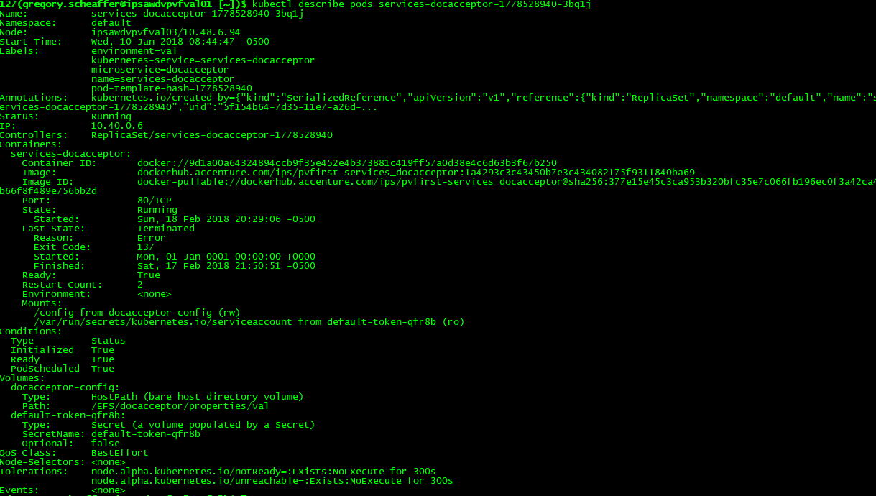
Pod Troubleshooting – Images
The first step in troubleshooting a pod is identifying the current state of the pod. This is done by executing, kubectl describe pods <POD_NAME>. With this command, you are given high-level details regarding the pod. In particular, you should identify the state of the pod.

Slide 64
Pod Troubleshooting – Pending
If the pod is stuck in a Pending state, that means that the pod cannot be scheduled to a node in it’s current state.
This is typically a result of insufficient resources that prevent scheduling. There may not be enough CPU or memory in the cluster due to Resource Requests or the node itself. To resolve this, you will need to either delete pods, adjust resource requests or add additional nodes (or resources) to the cluster.
Another possible reason that the pod could not be scheduled is due to the usage of hostPort. When you bind a pod to a hostPort, there are a limited number of ports that can be used. In most cases, hostPort is not necessary and a Service can be used to expose the pod.
There should be a message from the scheduler detailing why the pod(s) cannot be scheduled.

Slide 65
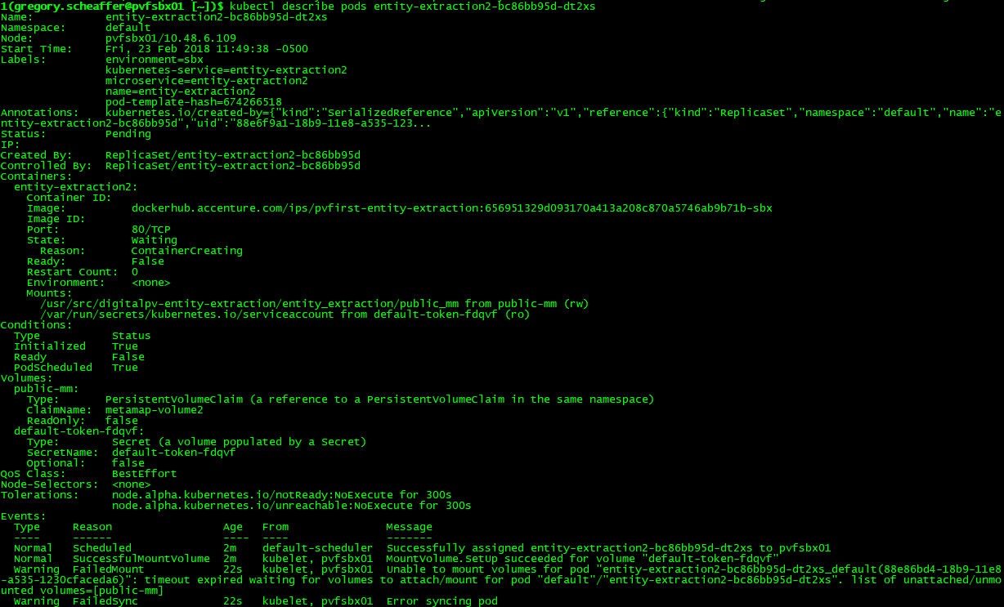
Pod Troubleshooting – ContainerCreating
When you execute kubectl get pods, you may see that a pod is stuck in a ContainerCreating state. However, when you execute kubectl describe pods <POD_NAME>, you see that it is in a pending state.
This is most likely a result of the pod waiting on additional Kubernetes objects, such as PersistentVolumes or Secrets, to be deployed if they have been mounted to the pod. Services are an exception to this as they are abstracted from the Pod. To identify if it is an issue with other Kubernetes objects, review the Events section which will have logs identifying objects pending.

Slide 66
Pod Troubleshooting – Waiting
If the pod is stuck in a Waiting state, that means that the pod has been scheduled to a node but cannot run on that machine.
This is typically a result of failure to pull the image. To identify if it is an issue with the image, make sure the name and version of the image is correct. You should also check to see if the image was pushed to the repository and if you can pull the image on your local machine by running docker pull <image>.

Slide 67
Pod Troubleshooting – Unhealthy/Crashing
If the pod is stuck in a CrashLoopBackOff or unhealthy state, that means that the pod has tried to start but was unable to successfully run and Kubernetes has stopped trying to start the pod.
The first step is to look at the logs of the current container by running kubectl logs <POD_NAME>. This command accepts -f and --tail=<number of lines> as options to help with debugging. These are the logs for the application running on the container. Determine if there are any logs that identify root cause.
Another option is to run commands within the container. You can do this by running kubectl exec <POD_NAME> -c <CONTAINER_NAME> -- <CMD> <ARG1> <ARG2> … Note that the -c <CONTAINER_NAME> is optional if there is only one container within the pod. Using this command can help identify logs within a pod. For example, this can help get the logs for a Cassandra pod, kubectl exec cassandra -- cat /var/log/cassandra/system.log.
The third option is to attach to the container if it is running and look throug the file system directly on the pod. In order to do this, you run kubectl exec –ti <POD_NAME> <ARG1> where <ARG1> is used to open a shell such as bash.

Slide 68
Pod Troubleshooting – Not Functional
If the pod is healthy, but not running as you expected, then there may be an issue with the pod definition. You need to review the YAML to ensure that it was defined as it should. Errors within the YAML may not always result in the failure of pod creation. For example, if a command was misspelled, the pod would create, but the command would not run as intended.
After review of the YAML, you can delete the pod and try to recreate it with the --validate flag being used. This will provide an error message if there is something wrong like a misspelling.
The next step is to compare the YAML that was used to create the pod against the original YAML. To do this, you can review the YAML that the pod is using by executing kubectl get pods <POD_NAME> -o yaml.

Slide 69
Application Troubleshooting – Replication Controller
During the troubleshooting process, it is important to ensure that if you are using a replication controller, that it is able to recreate pods. If it can recreate pods, then the issue is not with the replication controller or deployment.
You can use kubectl describe rc <CONTROLLER_NAME> to inspect the events related to the replication controller.

Slide 70
Application Troubleshooting – Services
If you have identified that the application (i.e. pod & replication controller) are not the issue, then the next step is to triage the service(s) utilized by the application. The Service is the backbone of the pod’s networking component.
To identify the root cause of networking issues, follow the steps below:
Is the pod utilizing a service?
Was the service created?
Is the service properly configured (ex. NodePort, ClusterIP, etc.)?
Does the service have an endpoint?
Are we able to ping the endpoint & service IP from within a pod in the cluster?
Are we able to ping the endpoint & service DNS from within a pod in the cluster?
Are we able to connect to the endpoint & service from within a pod in the cluster?

Slide 71
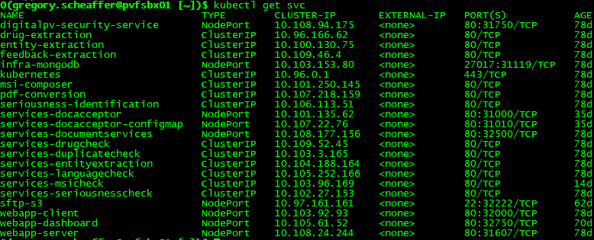
Services Troubleshooting – Creation
The first item that should be identified in regards to Services troubleshooting is the existence of the Service since they set the policy for how a pod is accessed.
The first step is to identify whether or not that the Service does in fact exist. To do this, you run the command kubectl get svc <SERVICE_NAME>. Note that <SERVICE_NAME> is optional, but without this argument, you will see all services within the namespace returned.
If the Service does not exist, then it must be created for the pod to be able to communicate within the cluster and to be exposed to users.

Slide 72
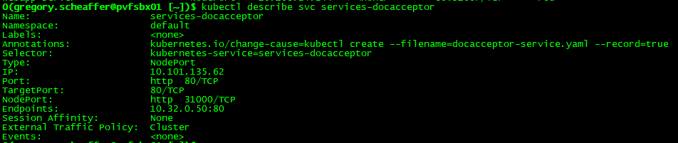
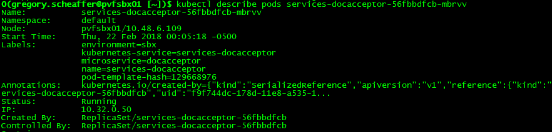
Services Troubleshooting – Utilization
The next step is to validate whether or not the pod(s) in question are utilizing the Service that was created. Depending on how you configured the Service will determine the debug steps. In the example below, we will discuss identifying if the pod is using the Service via Label Selector.
To identify the selector, run kubectl describe svc <SERVICE_NAME>.
The next step is to validate that there is a label, in this case kubernetes-services=services-docacceptor, within the pod in question.
If the label does not exist, then the pod will not use the Service.

Slide 73
Services Troubleshooting – Connection via DNS
After is has been confirmed that the Service does exist and is utilized by the pod, the next step is to identify if the Service can be reached either by DNS.
First, connect to any pod within the same namespace, kubectl exec –ti <POD_NAME> <ARG1> where <ARG1> opens a shell. Determine whether the DNS can be resolved, nslookup <SERVICE_NAME>. If this fails, it is possible that the pod and service are in different namespaces. To confirm this, try a namespace-qualified name, nslookup <SERVICE_NAME>.<NAMESPACE>. If this works, then you will need to adjust your application to use cross-namespace names.
If you are able to do a fully-qualified name lookup but not a relative one, you need to check that your /etc/resolv.conf file is correct.
If the above still fails - DNS lookups are not working for your Service - we need to take a step back and see what else is not working. The Kubernetes master Service should always work, nslookup kubernetes.default.
If this still fails, then the issue may be with kube-proxy which is covered later.

Slide 74
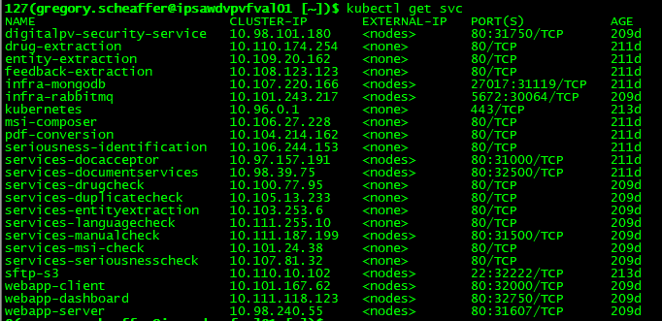
Services Troubleshooting – Connection via IP Address
Assuming that we have confirmed that DNS is working, the next step is to identify whether the Service can be reached by the IP address.
This can be done by curl <IP_ADDRESS>:<PORT>. The IP address to use in the curl command is either the result from the nslookup described in the previous slide or the Cluster-IP and internal port in the kubectl get svc return.
If the Service is running, then you will receive a response. If there is not response, continue on with troubleshooting.
Note: In the Port(s) section, it is <INTERNAL_PORT>:<EXPOSED_PORT>

Slide 75
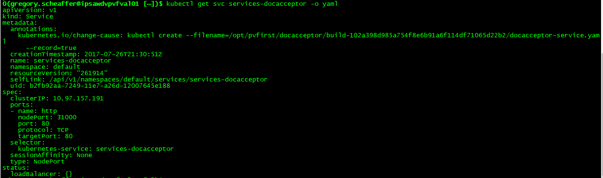
Services Troubleshooting – targetPorts
Assuming that we have confirmed that IP address is working as expected, the next area to look at is the service definition itself. We should confirm that we have identified the proper ports within the YAML.

Slide 76
Services Troubleshooting – Endpoint Creation
After we have identified that the Service definition has the proper ports, the next item to validate that the pods have endpoints. Without an endpoint, the pods cannot be selected by the Service.
The command kubectl get pods -l <LABEL_KEY>=<LABEL_VALUE> is used to validate that the pod is in fact still up and running. The option -l is a label selector.
Using the kubectl get endpoints <SERVICE_NAME> will help confirm whether that the endpoint controller has found the pods within the service.
If the endpoints are blank, then confirm that the correct selector has been used in the Services definition and that it matches the metadata labels within the pod(s). A common mistake is to have a typo or a key mismatch between Service and Pod definitions.

Slide 77
Services Troubleshooting – Connection to Application
After validating that the pods have been assigned to a Service, the last check is to confirm that you can connect to the application. While the pod is running and we have confirmed the ports, it is still possible that the pod is not functioning as expected.
To identify this, the use of kubectl logs and kubectl exec can be used to identify if there are any issues with the application and application dependencies such application properties that are not properly configured.

Slide 78
Kube-Proxy Troubleshooting – Status
At this point, we have identified that the Service is running, the Pods have endpoints and the Pods are serving. The next step is to debug the kube-proxy to identify if there is an issue with kube-proxy.
The first step is to confirm that kube-proxy is running on the node(s). This is done by running ps –eaf | grep kube-proxy.
After confirming that the kube-proxy is running, review the logs. The location of the logs will vary based on the Node OS, but for some OS distributions, you should be able to find it at /var/log/kube-proxy.log while other OS distributions require the usage of journalctl to access the logs.
If you see an error message about not being able to connect to the master node, confirm that the node configuration and installation steps were properly followed.
Another reason why kube-proxy cannot run correctly is that the required conntrack binary cannot be found. This may be the case on some Linux systems based on how the cluster is installed. If that is the case, then the conntrack package must be installed manually.

Slide 79
Kube-Proxy Troubleshooting – iptables
One of the main responsibilities of kube-proxy is to write the iptables rules which implement Services. The kube-proxy can run in either “userspace” mode or “iptables” mode.
Verify that kube-proxy is in fact writing to the iptables:

Slide 80
Kube-Proxy Troubleshooting – Proxy
Assuming that kube-proxy is writing to the iptables and you see the rules required, the next step is to try to access the Service by IP address.
If this fails and you are using the userspace proxy, you can try accessing the proxy directly.
Look back at the iptables-save output and identify the port number that kube-proxy is using for the Service. Once again, attempt to connect to the <IP_ADDRESS>:<PORT>
If this still fails, look at the kube-proxy logs for specific lines like:
Setting endpoints for <NAMESPACE>/<SERVICE_NAME>:<NAMESPACE> to [<IP_ADDRESS1>,<IP_ADDRESS2>, …]
If you don’t see those, try restarting kube-proxy with the -V flag set to 4, and then look at the logs again

Slide 81
Cluster Troubleshooting
The logs for a cluster can be found in the following locations.
Master Node:
/var/log/kube-apiserver.log - API Server, responsible for serving the API
/var/log/kube-scheduler.log - Scheduler, responsible for making scheduling decisions
/var/log/kube-controller-manager.log - Controller that manages replication controllers
Worker Nodes:
/var/log/kubelet.log - Kubelet, responsible for running containers on the node
/var/log/kube-proxy.log - Kube Proxy, responsible for service load balancin
Note: Depending on the OS, you may need to use journalctl instead.

Slide 82
Taints and Tolerations
For a deeper dive into Kubernetes, please feel free to use the following links:
Official Kubernetes Trainings:
Kubernetes Basics
Kubernetes 101
Kubernetes 201
Kubernetes – Cluster Operator
Kubernetes - Application Developer
Accenture Trainings:
Kubernetes Learning Boards
Kubernetes MyLearning

